Slide 1
Unlocking More From Your Audio Data
Braden Riggs PyData Global 2021 ~ Full Tutorial
Twitter: @BradenRiggs1

Slide 2
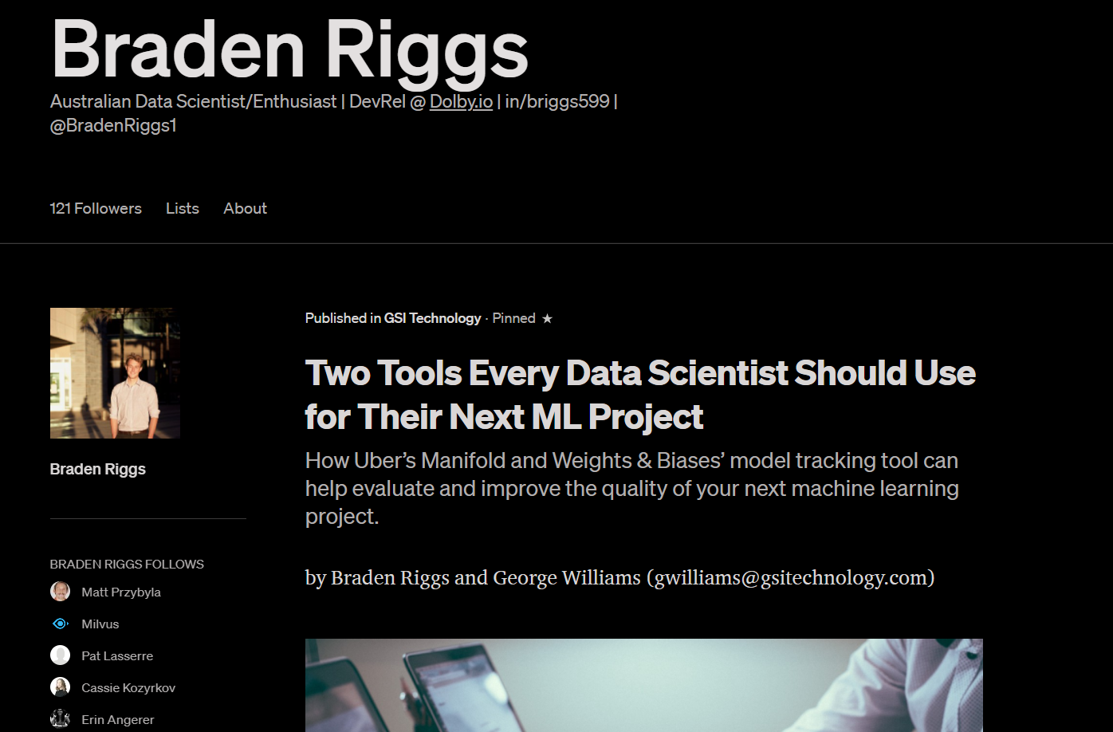

Who I am?
Twitter: @BradenRiggs1

Slide 3
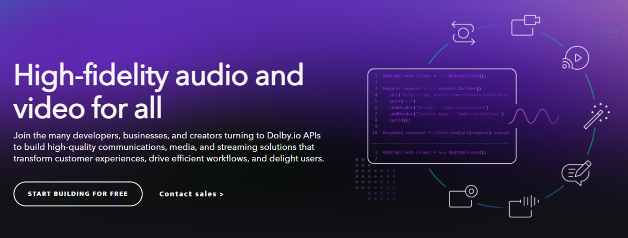
Dolby.io
Twitter: @BradenRiggs1

Slide 4
What is Audio Data?
Air pressure to digital
Sample Rate
Bit-depth
Twitter: @BradenRiggs1

Slide 5
What is Audio Data?
Air pressure to digital
Sample Rate
Bit-depth
44100 * 16 * 1 second = 86.13 KiloBytes
For one second of audio!
Twitter: @BradenRiggs1

Slide 6
What is Audio Data?
Air pressure to digital
Sample Rate
Bit-depth
Unstructured data
86 Kbytes vs 2 Kbytes
Don’t lose all that data!
Twitter: @BradenRiggs1

Slide 7
What is Audio Data?
Air pressure to digital
Sample Rate
Bit-depth
Unstructured data
86 Kbytes vs 2 Kbytes
Don’t lose all that data!
Limitless possibilities
Audio data is sneaky big data.
Twitter: @BradenRiggs1

Slide 8
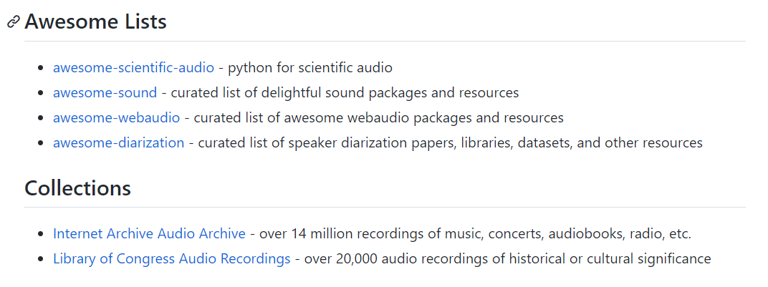
Where to find Audio Data?
https://github.com/DolbyIO/awesome-audio
Twitter: @BradenRiggs1

Slide 9
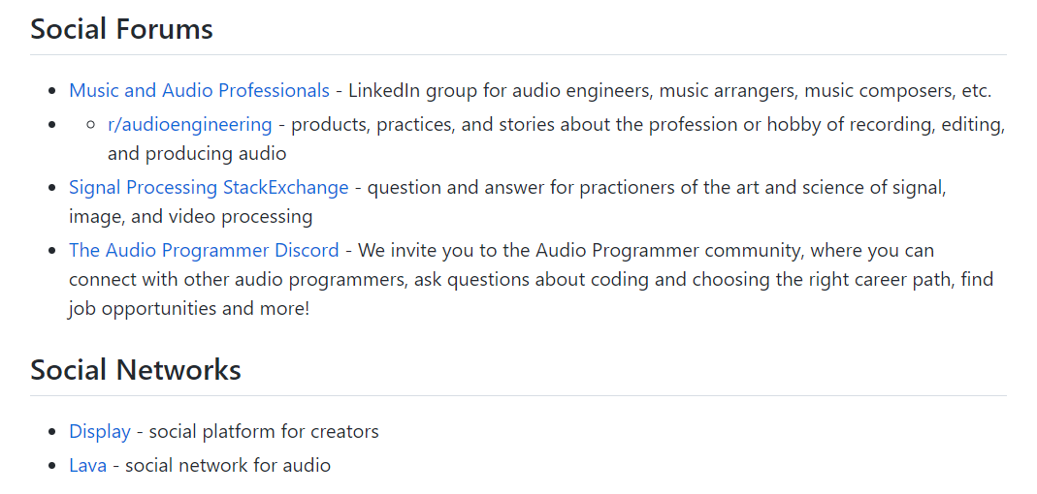
Where to find Audio Data?
https://github.com/DolbyIO/awesome-audio
Twitter: @BradenRiggs1

Slide 10
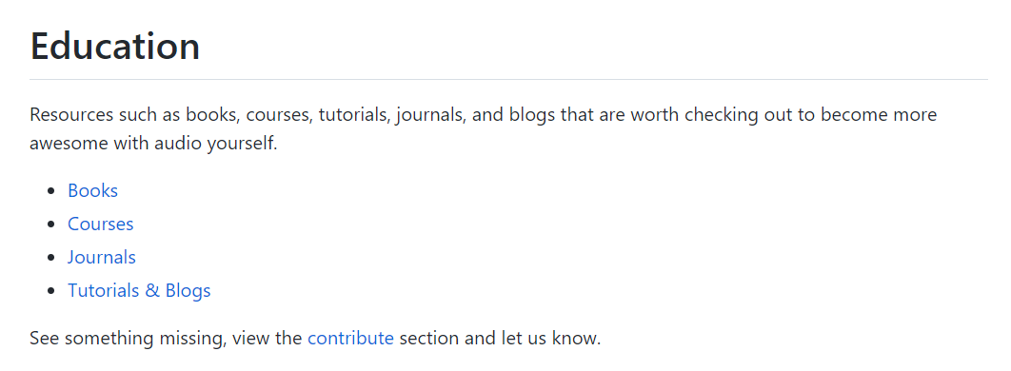
Where to find Audio Data?
https://github.com/DolbyIO/awesome-audio
Twitter: @BradenRiggs1

Slide 11
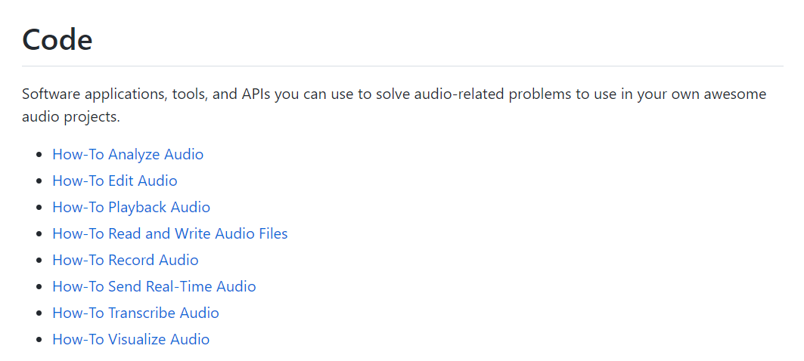
Where to find Audio Data?
https://github.com/DolbyIO/awesome-audio
Twitter: @BradenRiggs1

Slide 12
Where to find Audio Data?
https://github.com/DolbyIO/awesome-audio
We are looking for more contributors!
Twitter: @BradenRiggs1

Slide 13
Three Tools to Unlock More
Let's go look at the code: https://github.com/Briggs599/audio_data_DolbyIO
Twitter: @BradenRiggs1

Slide 14
Three Tools to Unlock More
Let's go look at the code: https://github.com/Briggs599/audio_data_DolbyIO
20 Sports Podcast Episodes
Download data
Audio files as .WAV
Each ep roughly 60 to 100 Mins
What can we learn about the underlying audio?
Twitter: @BradenRiggs1

Slide 15

Share your ideas, win API minutes: https://go.dolby.io/pydata-2021
Spooky Thought Starter: - Can you detect the most intense segments in a true crime podcast?

Slide 16
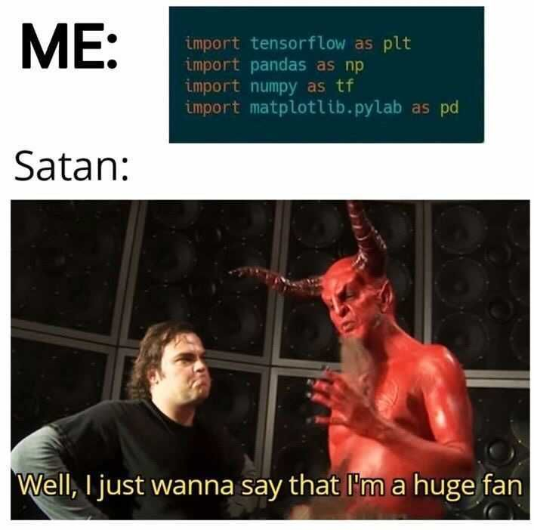
Break
Share your ideas, win API minutes: https://go.dolby.io/pydata-2021
Twitter: @BradenRiggs1

Slide 17
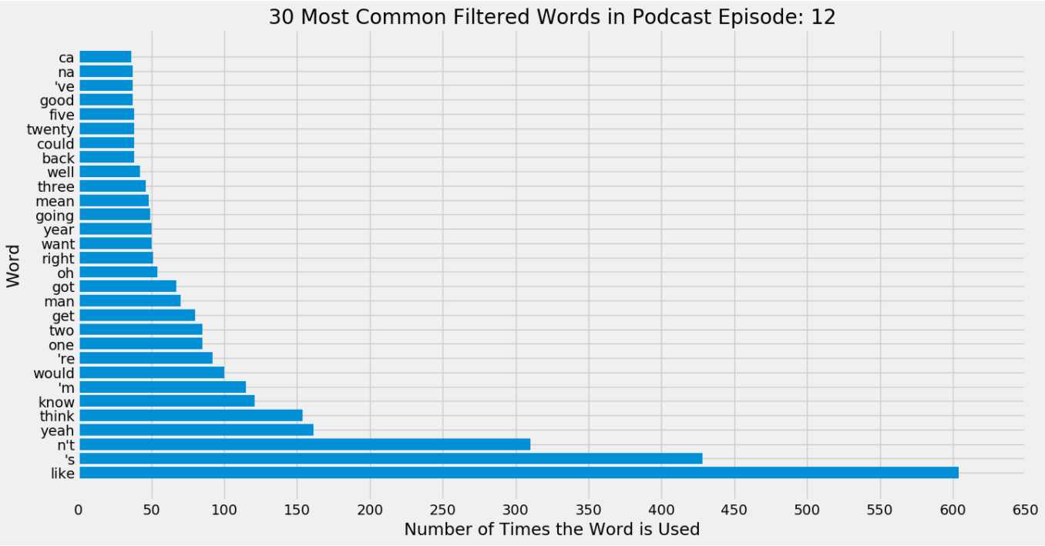
To Recap!
Share your ideas, win API minutes: https://go.dolby.io/pydata-2021
Twitter: @BradenRiggs1

Slide 18
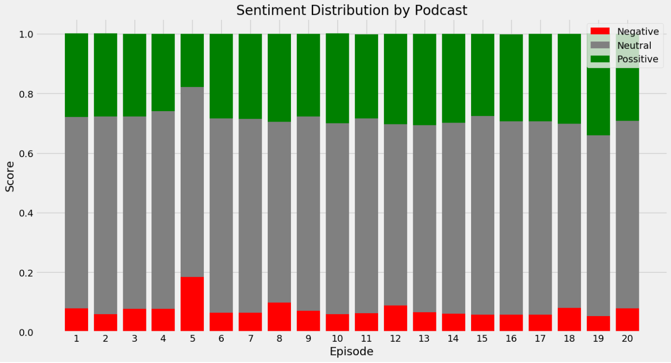
To Recap!
Share your ideas, win API minutes: https://go.dolby.io/pydata-2021
Twitter: @BradenRiggs1

Slide 19
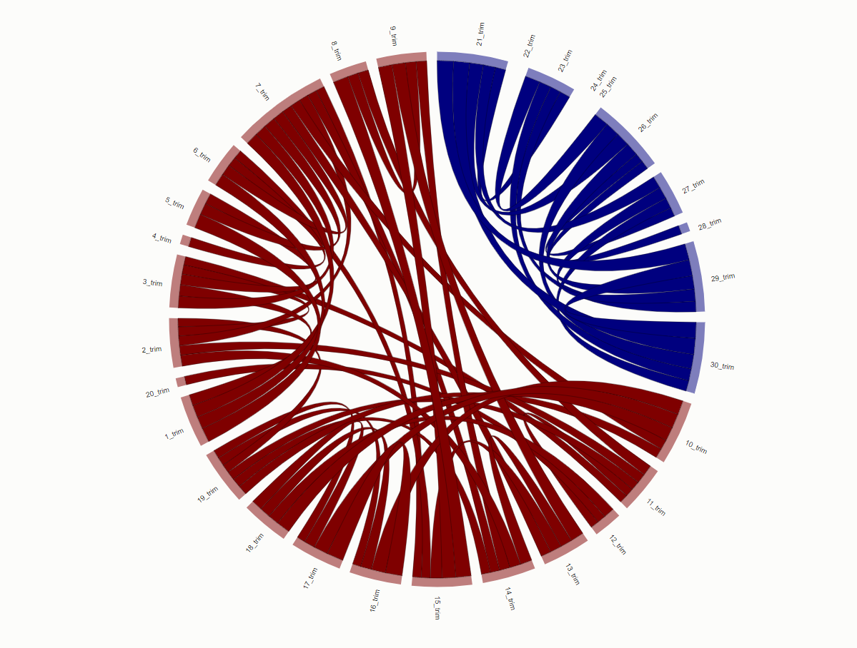
To Recap!
Share your ideas, win API minutes: https://go.dolby.io/pydata-2021
Twitter: @BradenRiggs1

Slide 20
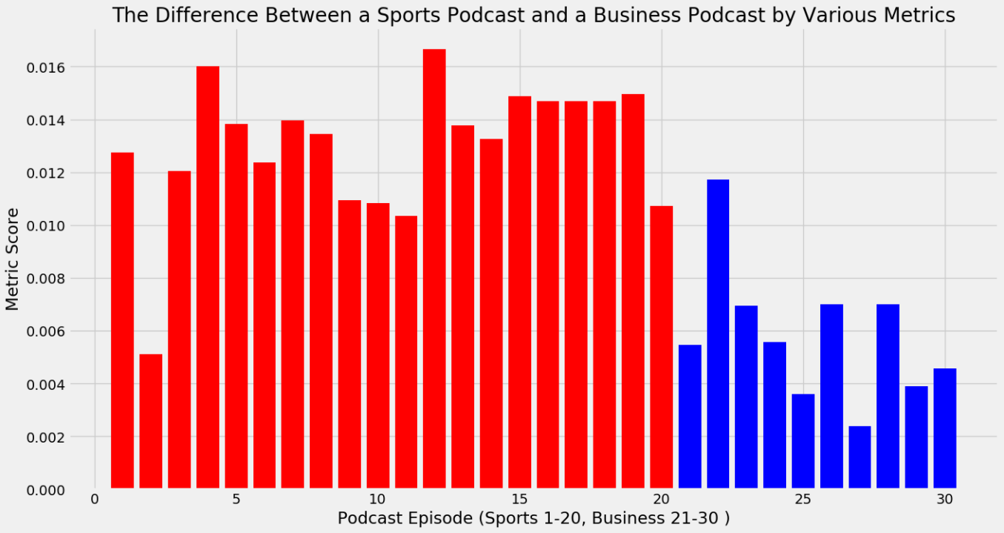
To Recap!
Share your ideas, win API minutes: https://go.dolby.io/pydata-2021
Twitter: @BradenRiggs1

Slide 21
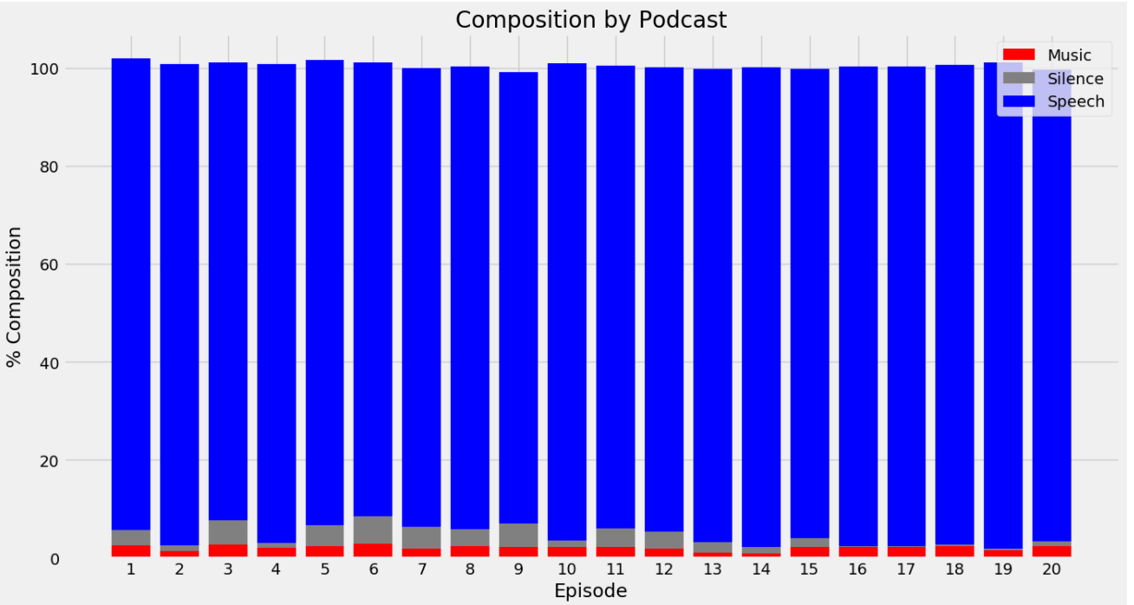
To Recap!
Share your ideas, win API minutes: https://go.dolby.io/pydata-2021
Twitter: @BradenRiggs1

Slide 22
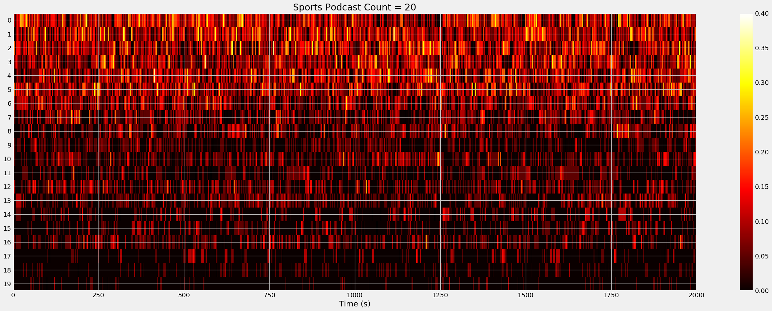
To Recap!
Share your ideas, win API minutes: https://go.dolby.io/pydata-2021
Twitter: @BradenRiggs1

Slide 23
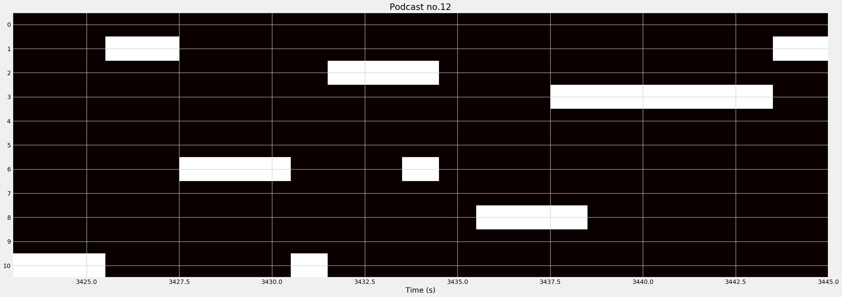
To Recap!
Share your ideas, win API minutes: https://go.dolby.io/pydata-2021
Twitter: @BradenRiggs1

Slide 24
To Recap! (Go Bucks?)
Share your ideas, win API minutes: https://go.dolby.io/pydata-2021
Twitter: @BradenRiggs1

Slide 25
Let's look at a few of your ideas…
Share your ideas, win API minutes: https://go.dolby.io/pydata-2021
Twitter: @BradenRiggs1

Slide 26
Share your ideas, win API minutes: https://go.dolby.io/pydata-2021
Interested in our Analyze Audio APIs? https://docs.dolby.io/media-apis/docs
Twitter: @BradenRiggs1

